Slide 1
1 meter of elevation head
1 meter
Reference elevation
1 meter of pressure head
1 meter of velocity head

Slide 2
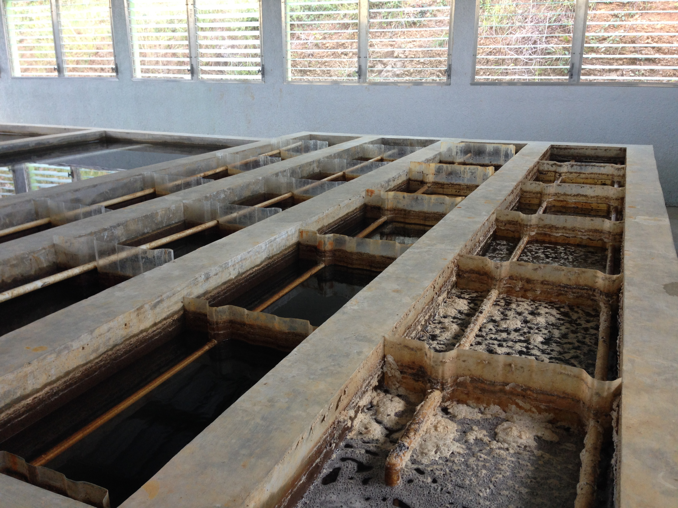
AguaClara Flocculator
Top Baffles
Bottom Baffles, underwater

Slide 3
AguaClara Flocculator

Slide 4
AguaClara Flocculator
Top and Bottom Baffles
Top Baffles
Bottom Baffles, underwater
Flocculator Channels
Flow Path

Slide 5








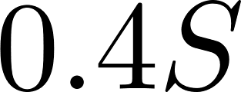
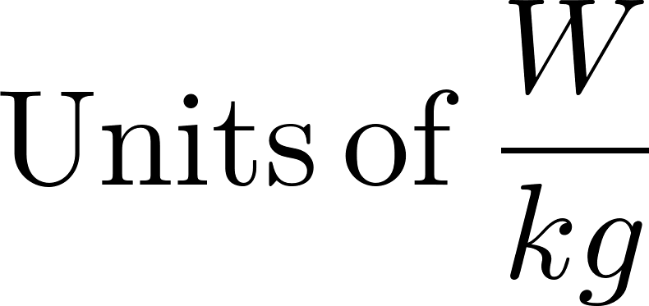

Slide 6



Slide 7



Calibrate at max flow

Slide 8





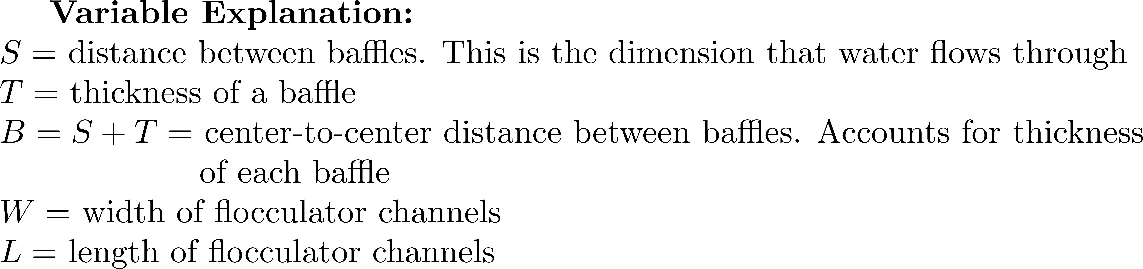
Top Baffles
Water
flow path
Vertical
Flocculator:
Side-view
Bottom Baffles
Plan-view

Slide 9

Set of obstacles,
3 per baffle in this design
Top baffles
Single obstacle
Bottom baffles

Slide 10

Sutro Weir
LFOM

Slide 11


No obstacles
1 obstacle
per baffle
Water
flow path
Water
flow path
Obstacles

Slide 12




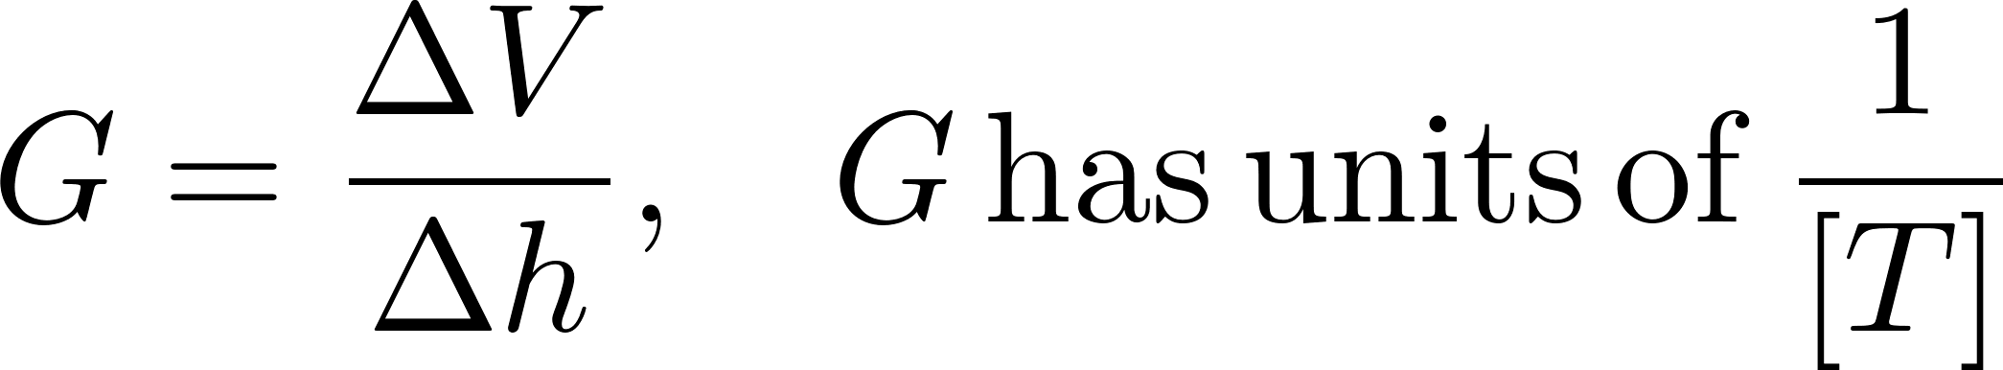

Slide 13



Slide 14



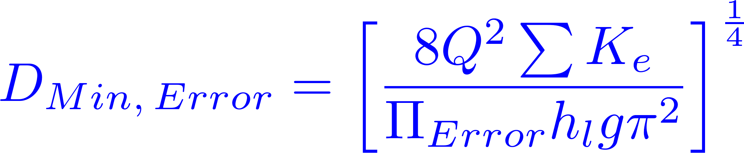



Slide 15

Small diameter tubing

Slide 16


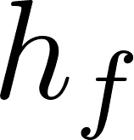
Air vent
Tube from the stock tank
Float valve
Holes to choose the dose
Flexible tube
Raw water
Rapid Mix
Orifice

Slide 17
V_{in}
V_{out}
A_{in}
x
A_{out}
in
out

Slide 18
Horizontal orifice
Vertical orifice

Slide 19
Overhead Tank
Constant head orifice
Overflow pipe
Pump

Slide 20


A
B

Slide 21
Pipe stub
Pipe coupling
Drain piping

Slide 22

AutoCAD drawing of sedimentation tank, don’t worry if this is confusing!
You’ll learn about it in depth later on.
Sedimentation
tank drain

Slide 23


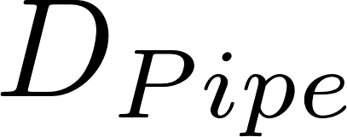
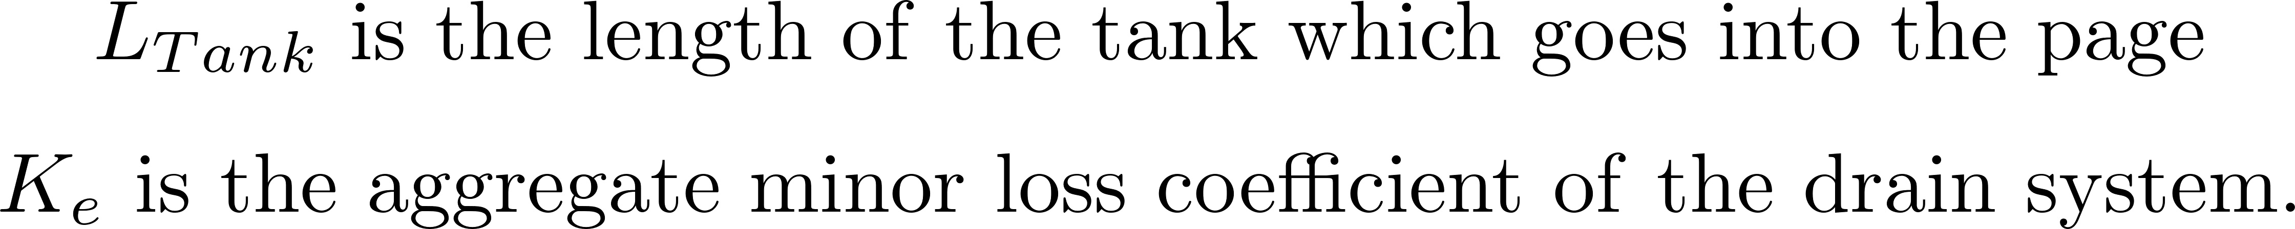

Slide 24

Float
Float
Orifice
Orifice
Transparent flexible tube
Transparent flexible tube

Slide 26
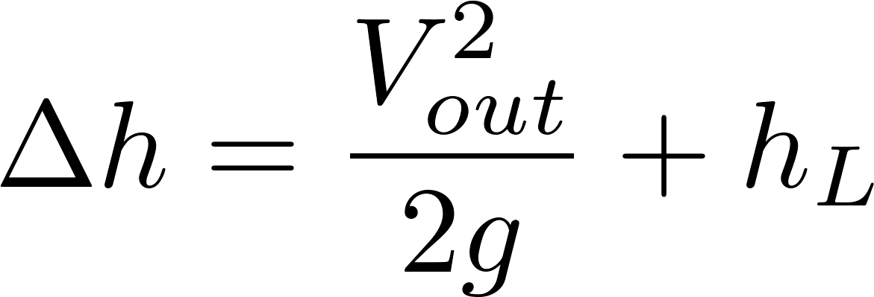
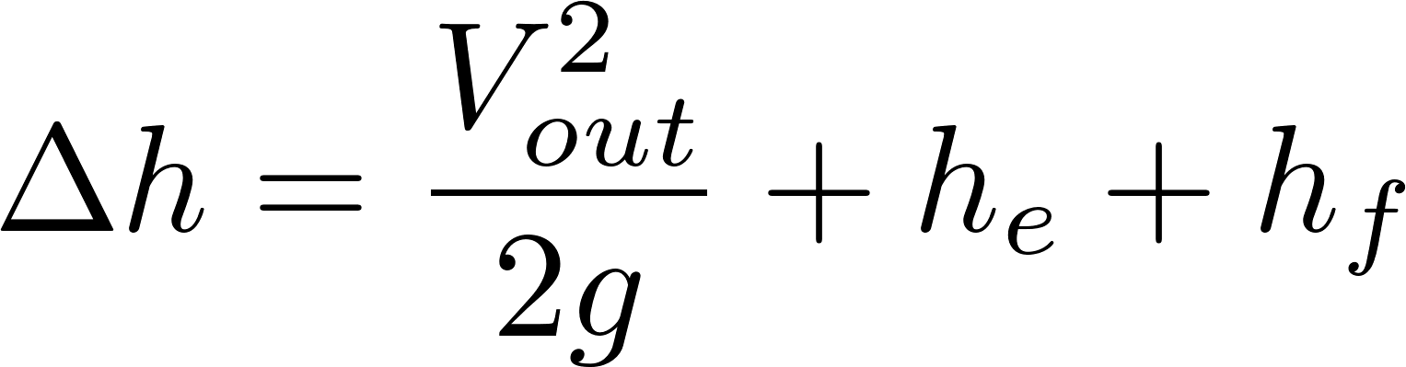
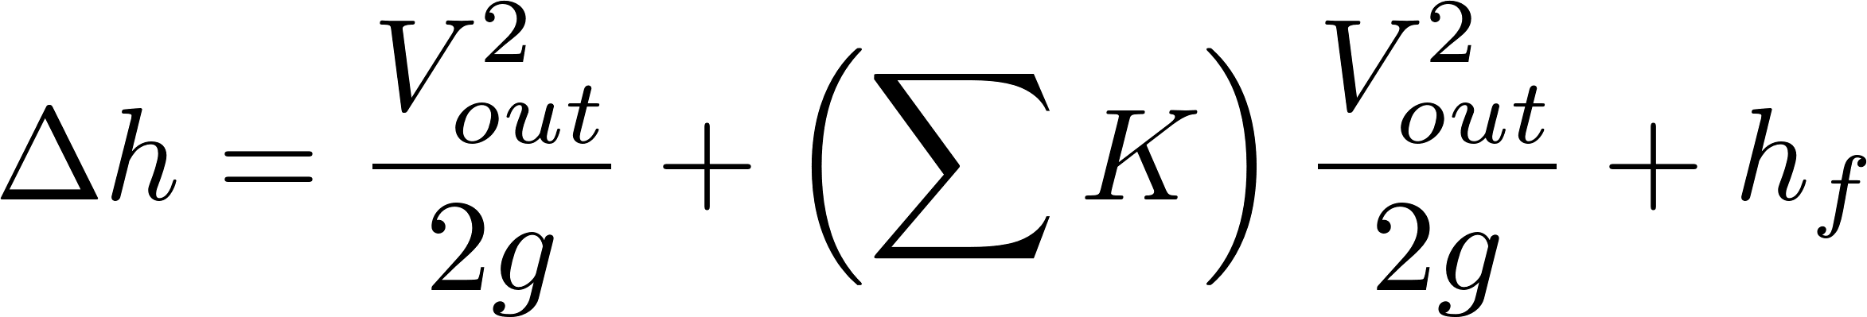
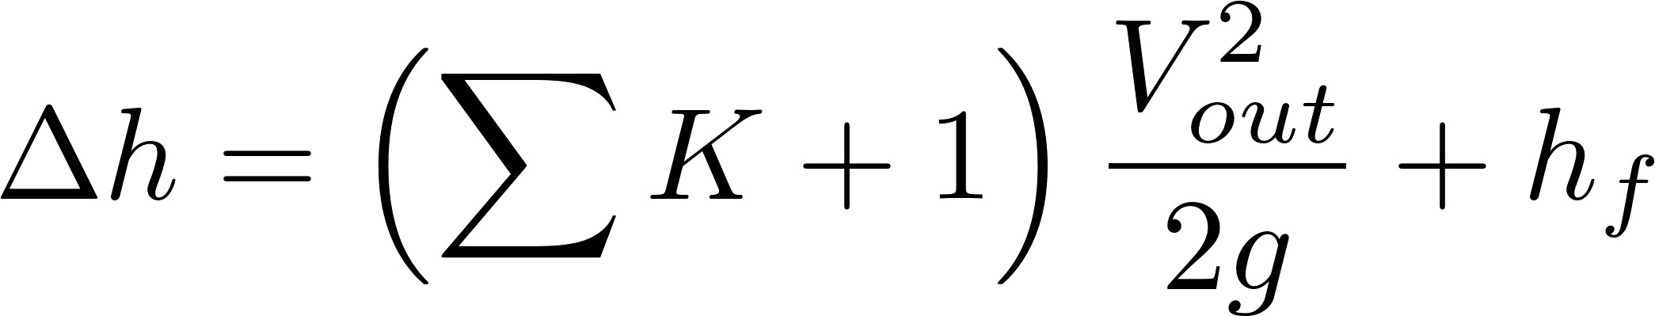
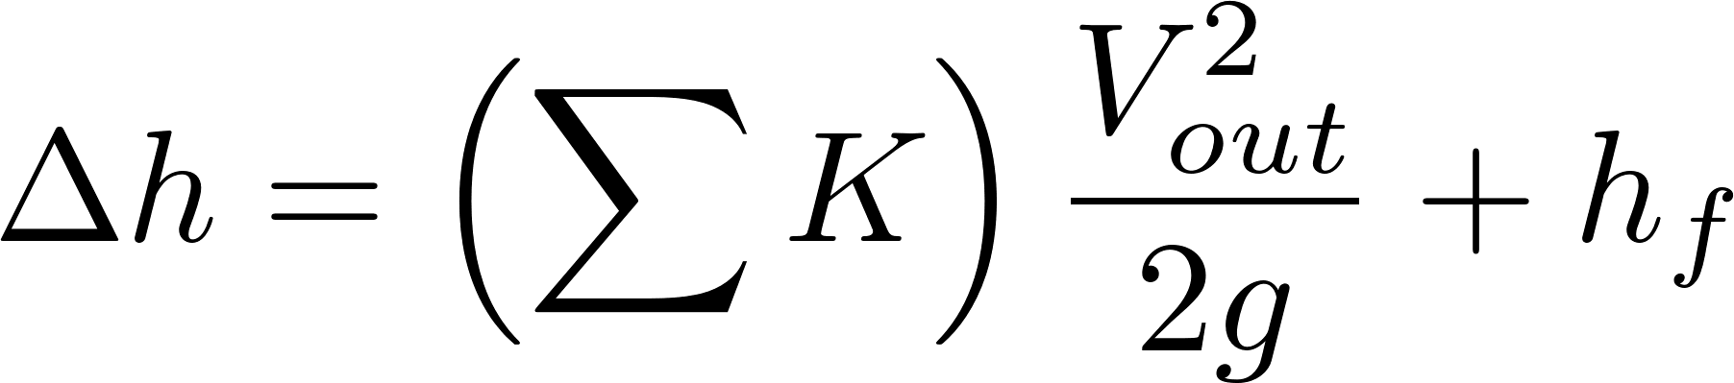
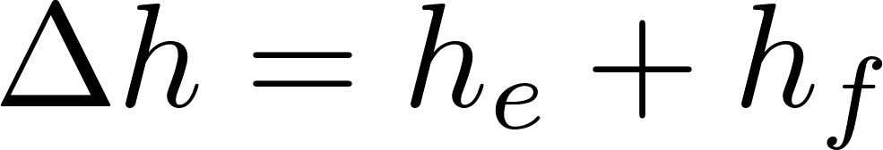

Simplified
energy equation
Just adding
K = 1 to the sum

Slide 27
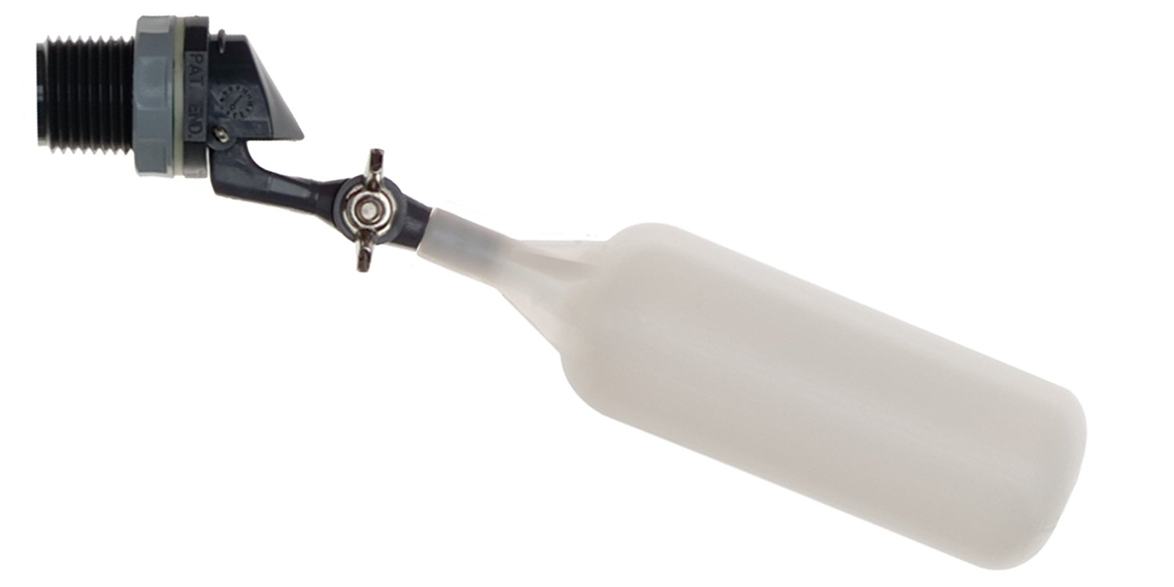
Flow of water
out of valve
Range of
motion of float
Float

Slide 28
C
B
A

Slide 29
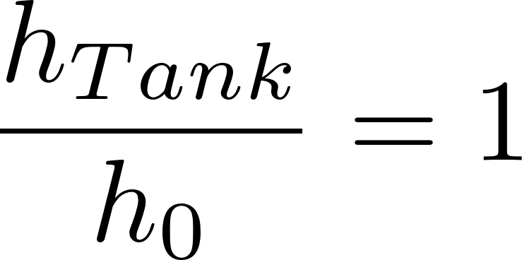
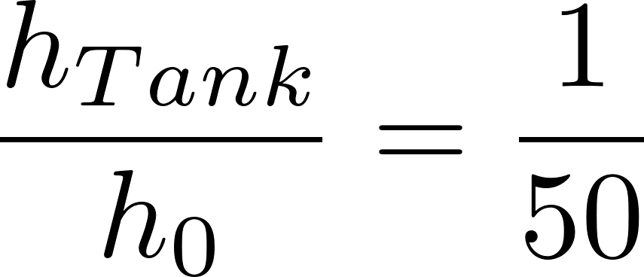
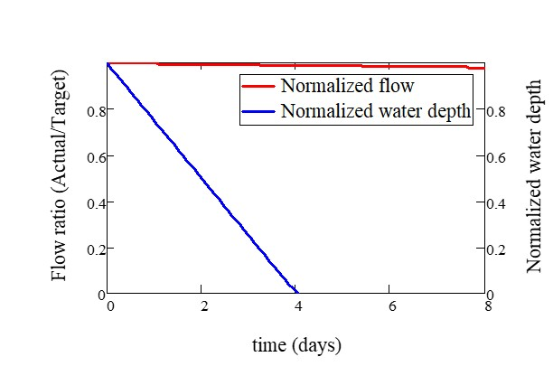
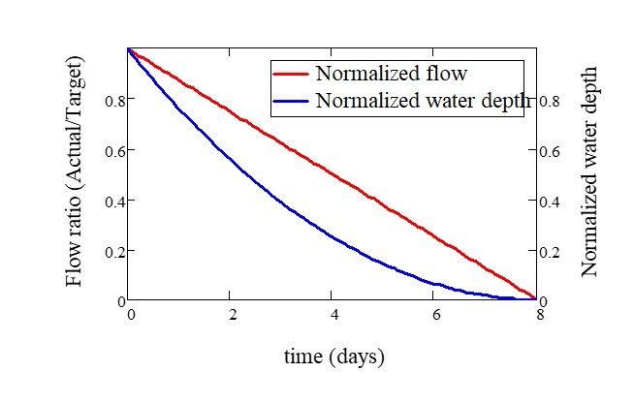

Slide 30


Tank
Valve
Water source pipe
Tank
Valve
Water source pipe

